Slide 1
Security
Course Code: CSC 2209
Course Title: Operating Systems
Dept. of Computer Science
Faculty of Science and Technology
Lecturer No: | 12 | Week No: | 12 | Semester: | Summer 2022-23
Lecturer: | Taslimur Rahman; Taslimur.Rahman@aiub.edu

Slide 2
Lecture Outline
The Security Problem
Program Threats
System and Network Threats

Slide 3
The Security Problem
System secure if resources used and accessed as intended under all circumstances
Unachievable
Intruders (crackers) attempt to breach security
Threat is potential security violation
Attack is attempt to breach security
Attack can be accidental or malicious
Easier to protect against accidental than malicious misuse

Slide 4
Security Violation Categories
Breach of confidentiality
Unauthorized reading of data
Breach of integrity
Unauthorized modification of data
Breach of availability
Unauthorized destruction of data
Theft of service
Unauthorized use of resources
Denial of service (DOS)
Prevention of legitimate use
Notes:
A Denial-of-Service (DoS) attack is an attack meant to shut down a machine or network, making it inaccessible to its intended users. DoS attacks accomplish this by flooding the target with traffic, or sending it information that triggers a crash. In both instances, the DoS attack deprives legitimate users (i.e. employees, members, or account holders) of the service or resource they expected.

Slide 5
Security Violation Methods
Masquerading (breach authentication)
Pretending to be an authorized user to escalate privileges
Replay attack
As is or with message modification
Man-in-the-middle attack
Intruder sits in data flow, masquerading as sender to receiver and vice versa
Session hijacking
Intercept an already-established session to bypass authentication
Privilege escalation
Common attack type with access beyond what a user or resource is supposed to have
Notes:
A masquerade attack is an attack that uses a fake identity, such as a network identity, to gain unauthorized access to personal computer information through legitimate access identification. If an authorization process is not fully protected, it can become extremely vulnerable to a masquerade attack.
A replay attack (also known as playback attack) is a form of network attack in which a valid data transmission is maliciously or fraudulently repeated or delayed.
A man-in-the-middle attack (MITM) is an attack where the attacker secretly relays and possibly alters the communications between two parties who believe that they are directly communicating with each other.
The Session Hijacking attack consists of the exploitation of the web session control mechanism, which is normally managed for a session token. Because http communication uses many different TCP connections, the web server needs a method to recognize every user's connections.
Privilege escalation happens when a malicious user exploits a bug, design flaw, or configuration error in an application or operating system to gain elevated access to resources that should normally be unavailable to that user. The attacker can then use the newly gained privileges to steal confidential data, run administrative commands or deploy malware – and potentially do serious damage to your operating system, server applications, organization, and reputation.

Slide 6
Security Measure Levels
Impossible to have absolute security, but make cost to perpetrator sufficiently high to deter most intruders
Security must occur at four levels to be effective:
Physical
Data centers, servers, connected terminals
Application
Benign or malicious apps can cause security problems
Operating System
Protection mechanisms, debugging
Network
Intercepted communications, interruption, DOS
Security is as weak as the weakest link in the chain
Humans a risk too via phishing and social-engineering attacks
But can too much security be a problem?

Slide 7
Program Threats
Many variations, many names
Trojan Horse
Code segment that misuses its environment
Exploits mechanisms for allowing programs written by users to be executed by other users
Spyware, pop-up browser windows, covert channels
Up to 80% of spam delivered by spyware-infected systems
Trap Door
Specific user identifier or password that circumvents normal security procedures
Could be included in a compiler
How to detect them?
Notes:
In a Trojan horse attack, a criminal disguises malware as a legitimate piece of software (like a program or app) or even a harmless document (like a spreadsheet) to trick users into willingly installing it on their computer.
A trap door or back door is an undocumented way of gaining access to a system that is built into the system by its designer(s). It can also be a program that has been altered to allow someone to gain privileged access to a system or process.

Slide 8
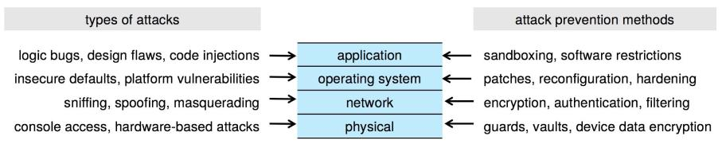
Four-layered Model of Security

Slide 9
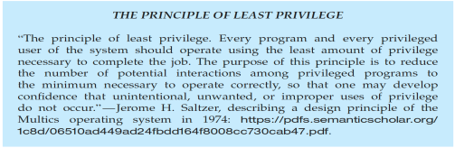
Program Threats (cont’d)
Malware - Software designed to exploit, disable, or damage computer
Trojan Horse – Program that acts in a clandestine manner
Spyware – Program frequently installed with legitimate software to display adds, capture user data
Ransomware – locks up data via encryption, demanding payment to unlock it
Others include trap doors, logic boms
All try to violate the Principle of Least Privilege
Goal frequently is to leave behind Remote Access Tool (RAT) for repeated access

Slide 10
C Program with Buffer-overflow Condition
#include <stdio.h>
#define BUFFER SIZE 256
int main(int argc, char *argv[])
{
char buffer[BUFFER SIZE];
if (argc < 2)
return -1;
else {
strcpy(buffer,argv[1]);
return 0;
}
}
Code review can help – programmers review each other’s code, looking for logic flows, programming flaws

Slide 11
Code Injection
Code-injection attack occurs when system code is not malicious but has bugs allowing executable code to be added or modified
Results from poor or insecure programming paradigms, commonly in low level languages like C or C++ which allow for direct memory access through pointers
Goal is a buffer overflow in which code is placed in a buffer and execution caused by the attack
Can be run by script kiddies – use tools written but exploit identifiers
Notes:
In an injection attack, an attacker supplies untrusted input to a program. This input gets processed by an interpreter as part of a command or query. In turn, this alters the execution of that program. Injections are amongst the oldest and most dangerous attacks aimed at web applications.

Slide 12
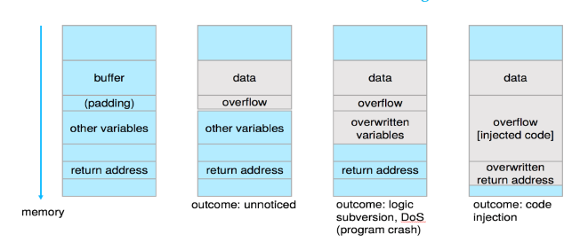
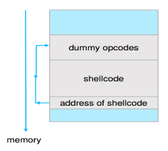
Code Injection (cont’d)
Outcomes from code injection include:
Frequently use trampoline to code execution to exploit buffer overflow:

Slide 13
Great Programming Required?
For the first step of determining the bug, and second step of writing exploit code, yes
Script kiddies can run pre-written exploit code to attack a given system
Attack code can get a shell with the processes’ owner’s permissions
Or open a network port, delete files, download a program, etc
Depending on bug, attack can be executed across a network using allowed connections, bypassing firewalls
Buffer overflow can be disabled by disabling stack execution or adding bit to page table to indicate “non-executable” state
Available in SPARC and x86
But still have security exploits

Slide 14
Program Threats (cont’d)
Viruses
Code fragment embedded in legitimate program
Self-replicating, designed to infect other computers
Very specific to CPU architecture, operating system, applications
Usually borne via email or as a macro
Visual Basic Macro to reformat hard drive
Sub AutoOpen()
Dim oFS
Set oFS = CreateObject(’’Scripting.FileSystemObject’’)
vs = Shell(’’c:command.com /k format c:’’,vbHide)
End Sub

Slide 15
Program Threats (cont’d)
Virus dropper inserts virus onto the system
Many categories of viruses, literally many thousands of viruses
File / parasitic
Boot / memory
Macro
Source code
Polymorphic to avoid having a virus signature
Encrypted
Stealth
Tunneling
Multipartite
Armored

Slide 16
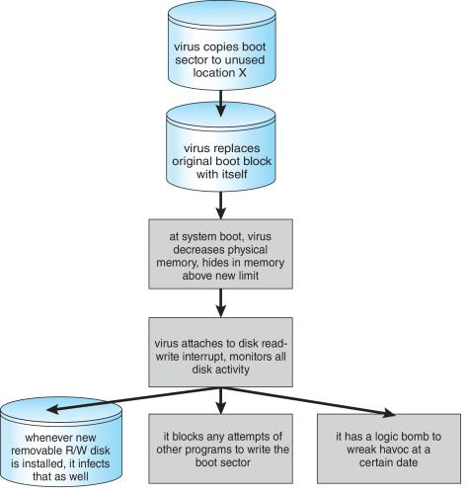
A Boot-sector Computer Virus

Slide 17
The Threat Continues
Attacks still common, still occurring
Attacks moved over time from science experiments to tools of organized crime
Targeting specific companies
Creating botnets to use as tool for spam and DDOS delivery
Keystroke logger to grab passwords, credit card numbers
Why is Windows the target for most attacks?
Most common
Everyone is an administrator
Licensing required?
Monoculture considered harmful

Slide 18
System and Network Threats
Some systems “open” rather than secure by default
Reduce attack surface
But harder to use, more knowledge needed to administer
Network threats harder to detect, prevent
Protection systems weaker
More difficult to have a shared secret on which to base access
No physical limits once system attached to internet
Or on network with system attached to internet
Even determining location of connecting system difficult
IP address is only knowledge

Slide 19
System and Network Threats (cont’d)
Worms – use spawn mechanism; standalone program
Internet worm
Exploited UNIX networking features (remote access) and bugs in finger and sendmail programs
Exploited trust-relationship mechanism used by rsh to access friendly systems without use of password
Grappling hook program uploaded main worm program
99 lines of C code
Hooked system then uploaded main code, tried to attack connected systems
Also tried to break into other users accounts on local system via password guessing
If target system already infected, abort, except for every 7th time

Slide 20
System and Network Threats (cont’d)
Port scanning
Automated attempt to connect to a range of ports on one or a range of IP addresses
Detection of answering service protocol
Detection of OS and version running on system
nmap scans all ports in a given IP range for a response
nessus has a database of protocols and bugs (and exploits) to apply against a system
Frequently launched from zombie systems
To decrease trace-ability

Slide 21
System and Network Threats (cont’d)
Denial of Service
Overload the targeted computer preventing it from doing any useful work
Distributed Denial-of-Service (DDoS) come from multiple sites at once
Consider the start of the IP-connection handshake (SYN)
How many started-connections can the OS handle?
Consider traffic to a web site
How can you tell the difference between being a target and being really popular?
Accidental – CS students writing bad fork() code
Purposeful – extortion, punishment
Port scanning
Automated tool to look for network ports accepting connections
Used for good and evil

Slide 22
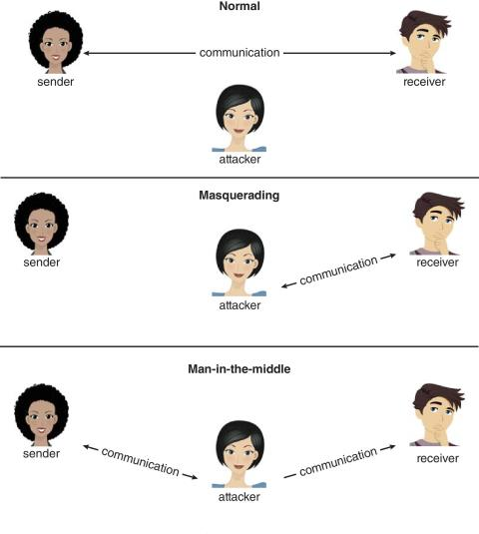
Standard Security Attacks

Slide 23
Books
Operating Systems Concept
Written by Galvin and Silberschatz
Edition: 9th

Slide 24
References
Operating Systems Concept
Written by Galvin and Silberschatz
Edition: 9th

